Slide 1
Notification Service System Design
13 Oct 2020
Oladipo Oyekanmi

Slide 2
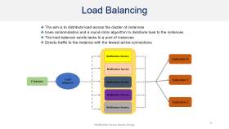
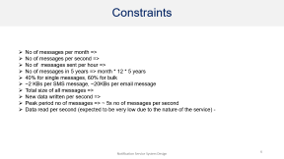
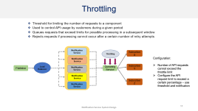
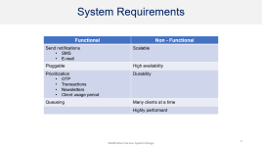
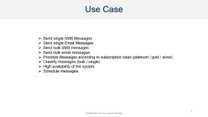
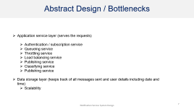
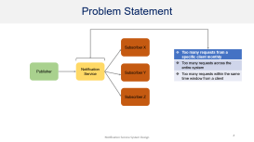
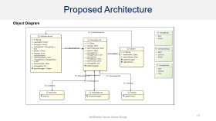
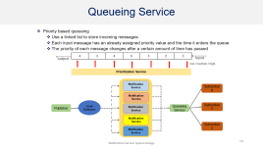
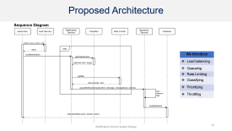
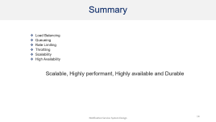
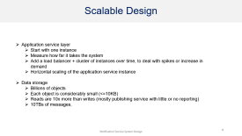
Outline

Slide 3
System Requirements
Functional | Non - Functional
Send notifications SMS E-mail | Scalable
Pluggable | High availability
Prioritization OTP Transactions Newsletters Client usage period | Durability
Queueing | Many clients at a time
 | Highly performant

Slide 4
Problem Statement
Subscriber X
Too many requests from a specific client monthly
Too many requests across the entire system
Too many requests within the same time window from a client
Publisher
Notification Service
Subscriber Y
Subscriber Z

Slide 5
Use Case
Send single SMS Messages
Send single Email Messages
Send bulk SMS messages
Send bulk email messages
Prioritize Messages according to subscription class (platinum / gold / silver)
Classify messages (bulk / single)
High availability of the system
Schedule messages

Slide 6
Constraints
No of messages per month =>
No of messages per second =>
No of messages sent per hour =>
No of messages in 5 years => month * 12 * 5 years
40% for single messages, 60% for bulk
~2 KBs per SMS message, ~20KBs per email message
Total size of all messages =>
New data written per second =>
Peak period no of messages => ~ 5x no of messages per second
Data read per second (expected to be very low due to the nature of the service) -

Slide 7
Abstract Design / Bottlenecks
Application service layer (serves the requests)
Authentication / subscription service
Queueing service
Throttling service
Load balancing service
Publishing service
Classifying service
Publishing service
Data storage layer (keeps track of all messages sent and user details including date and time)
Scalability

Slide 8
Scalable Design
Application service layer
Start with one instance
Measure how far it takes the system
Add a load balancer + cluster of instances over time, to deal with spikes or increase in demand
Horizontal scaling of the application service instance
Data storage
Billions of objects
Each object is considerably small (<=10KB)
Reads are 10x more than writes (mostly publishing service with little or no reporting)
10TBs of messages,

Slide 9
Load Balancing
The aim is to distribute load across the cluster of instances
Uses randomization and a round-robin algorithm to distribute load to the instances
The load balancer sends tasks to a pool of instances
Directs traffic to the instance with the fewest active connections
Notification Service
Subscriber X
Notification Service
Load Balancer
Subscriber Y
Publisher
Notification Service
Notification Service
Subscriber Z
Notification Service

Slide 10
Queueing Service
Priority based queueing
Use a linked list to store incoming messages
Each input message has an already assigned priority value and the time it enters the queue
The priority of each message changes after a certain amount of time has passed
output
4 | 3 | 4 | 5 | 3 | 2 | 3
input
low / medium / high
Prioritization Service
Notification Service
Subscriber X
Notification Service
Load Balancer
Subscriber Y
Publisher
Notification Service
Queueing Service
Notification Service
Subscriber Z
Notification Service

Slide 11
Throttling
Threshold for limiting the number of requests to a component
Used to control API usage by customers during a given period
Queues requests that exceed limits for possible processing in a subsequent window
Rejects requests if processing cannot occur after a certain number of retry attempts
Notification Service
Throttling
Subscriber X
Notification Service
Configuration:
Number of API requests cannot exceed the throttle limit
Configure the API request limit to exceed a certain percentage – use threshold and notification
Load Balancer
Subscriber Y
Publisher
Notification Service
Queueing Service
Notification Service
Subscriber Z
Notification Service

Slide 12
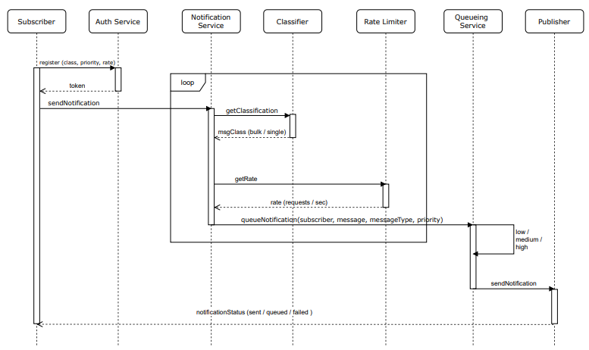
Proposed Architecture
Sequence Diagram
We Introduce
Load balancing
Queueing
Rate Limiting
Classifying
Prioritizing
Throttling

Slide 13
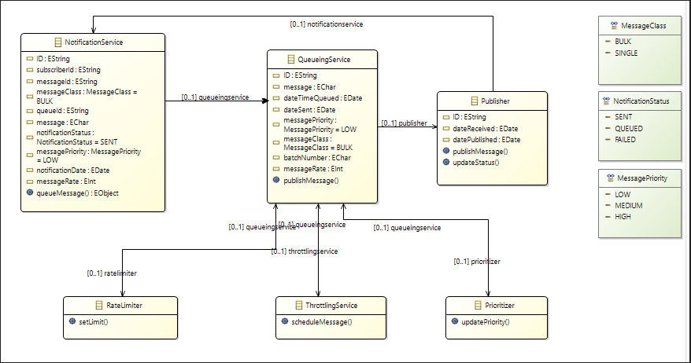
Proposed Architecture
Object Diagram

Slide 14
Summary
Load Balancing
Queueing
Rate Limiting
Throttling
Scalability
High Availability
Scalable, Highly performant, Highly available and Durable

